Slide 1

What are the states of matter?
By: Mariana Espinoza

Slide 2

But wait what is matter?
Matter is EVERYTHING around you!
It is anything that has mass and takes up space.

Slide 3
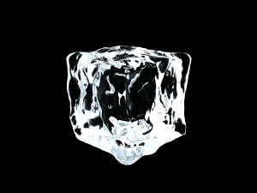


The three basic states of Matter are:
Solid Liquid Gas
http://www.chem4kids.com/files/matter_intro.html

Slide 4


Solid
It is characterized by structural rigidity and resistance to changes of shape or volume.

Slide 5

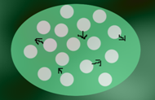
Liquid
is the only state with a definite volume but no fixed shape. It is made up of tiny vibrating particles of matter, such as atoms, held together by intermolecular bonds.

Slide 6

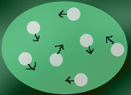
Gas
is pure gas may be made up of individual atoms, elemental molecules made from one type of atom. It is not rigid, has no fixed volume or shape.

Slide 7
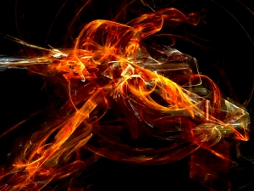
Plasma
(Intro only)
a fourth state of matter distinct from solid or liquid or gas and present in stars and fusion reactors; a gas becomes a plasma when it is heated until the atoms lose all their electrons.

Slide 8
Other vocabulary
Density: the degree of compactness of a substance
Atoms: the basic unit of a chemical element
Molecules: a group of atoms bonded together, representing the smallest fundamental unit of a chemical compound that can take part in a chemical reaction

Slide 9
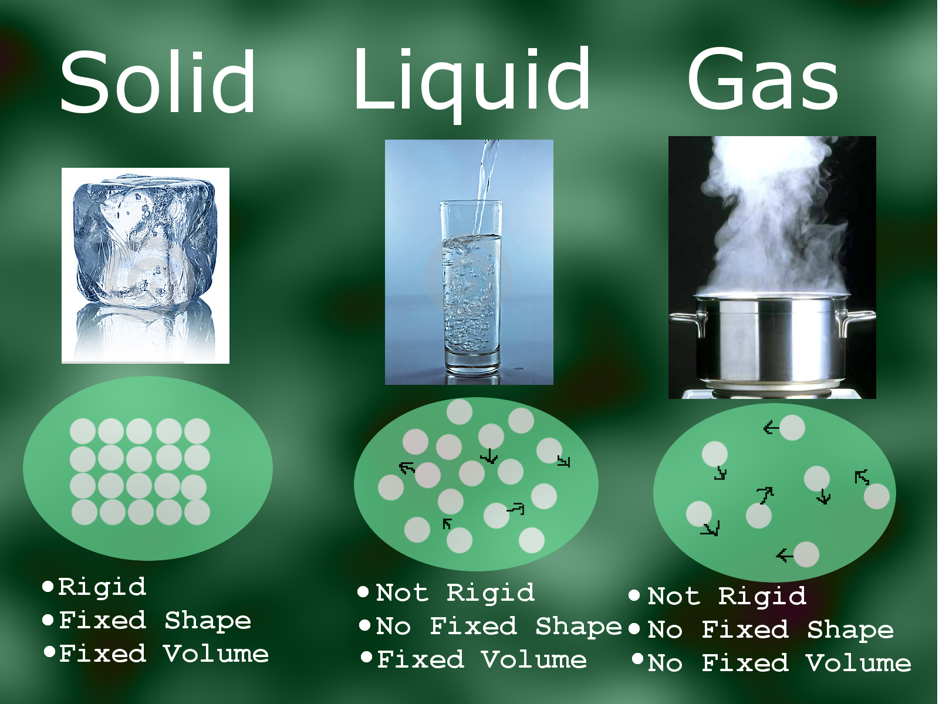

Slide 10
Work Cited
http://www.nyu.edu/pages/mathmol/textbook/whatismatter.html
http://www.chem4kids.com/files/matter_intro.html

